Slide 1
New! FAN® Online Reporting Tool
INTRODUCTION AND OVERVIEW
Notes:
Hello, and thank you for viewing this presentation on the new FAN Online Reporting Tool. I’m Tim McGee, Senior Manager of OTC Health and Clinical Operations at IMS.
The following slides will provide you with a short introduction and tutorial on the new FAN online reporting tool.

Slide 2
Features and Benefits
Streamlined and simple FAN reporting
24/7 online access via FAN52.com
Weekly National Summary HTML-based email
Additional reporting flexibility
Enhanced graphing features
Ability to export charts, graphs and data to Microsoft Excel
Global language settings
Notes:
IMS has developed a new web-based platform to host it’s weekly series of FAN reports. The new FAN Online Reporting Tool will replace your current Microsoft Excel deliverables.
Some of the features and benefits of the FAN Online Reporting Tool include:
A streamlined and easier to use FAN report, reducing the number of pages you will click through.
24/7 access to FAN reports at FAN52.com.
IMS will email the National Summary view each week.
Additional reporting flexibility will allow you to filter by attributes and create new reporting metrics on the fly.
New graphing features include drop-down menu’s and filters allowing users to change data output instantly.
Easily allows you to export any chart, graph or data table in to Microsoft Excel
Language settings will enable you to view FAN in the same language as your Internet Explorer settings

Slide 3
Website and Login
Notes:
You will be assigned a user name and password to access FAN52.com.
When at the log in page, you can log-in to the FAN Online Reporting Tool, or get additional information on the FAN program, such as supporting materials, overview presentations and frequently asked questions. A contact us now form will also be available for you to contact a member of the FAN support staff.
While FAN52.com is the home site for FAN, you will access FAN reports through the Vector Alpha link highlighted . Vector Alpha is an IMS product and services access point.

Slide 4
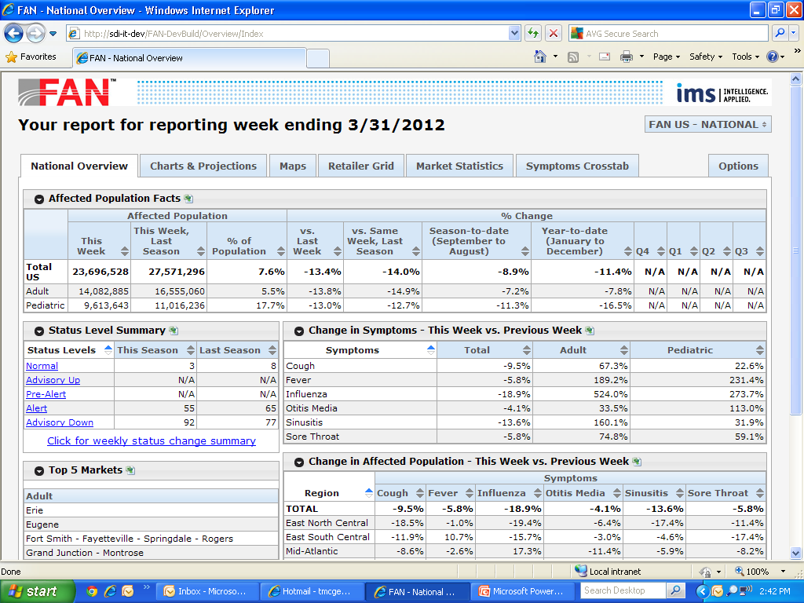
National Overview Page
Notes:
Upon logging in, you will be brought to the National Overview page for the most recent FAN report. This report will be emailed to you when the most recent data are made available.
In the new FAN Online Reporting tool, there are six major areas which line the top of the report:
- National Overview
Charts and Projections
Maps
Retailer Grid
Market Statistics
Symptoms Cross-tab
Each of these pages will be reviewed in the coming slides.
The National Overview page contains a top line summary of the current week’s national illness trends, including affected population statistics, current status level summary, changes in six core symptoms both nationally and regional and top markets. You will notice that the status level summary is a live field. When clicking on any status level, a list of markets entering their first week at that level will be available.
Another benefit to the new FAN Online Reporting Tool is a toggle feature for clients who receive multiple versions of FAN reports. You will have access to the reports you company subscribes to. By clicking on the report drop down menu, you will be able to toggle between your data reporting sets. In this example, user John Smith has access to FAN US National Reports, Target reports and Walgreen’s custom retailer reports.
The final component of the National Overview page is the programmable options tab. Do you have certain settings for age, symptoms, or markets which are used every time you access FAN reports? In the Online Reporting Tool, you can select settings and have them saved for future usage. Click the option tab and you will be brought to the options menu

Slide 5
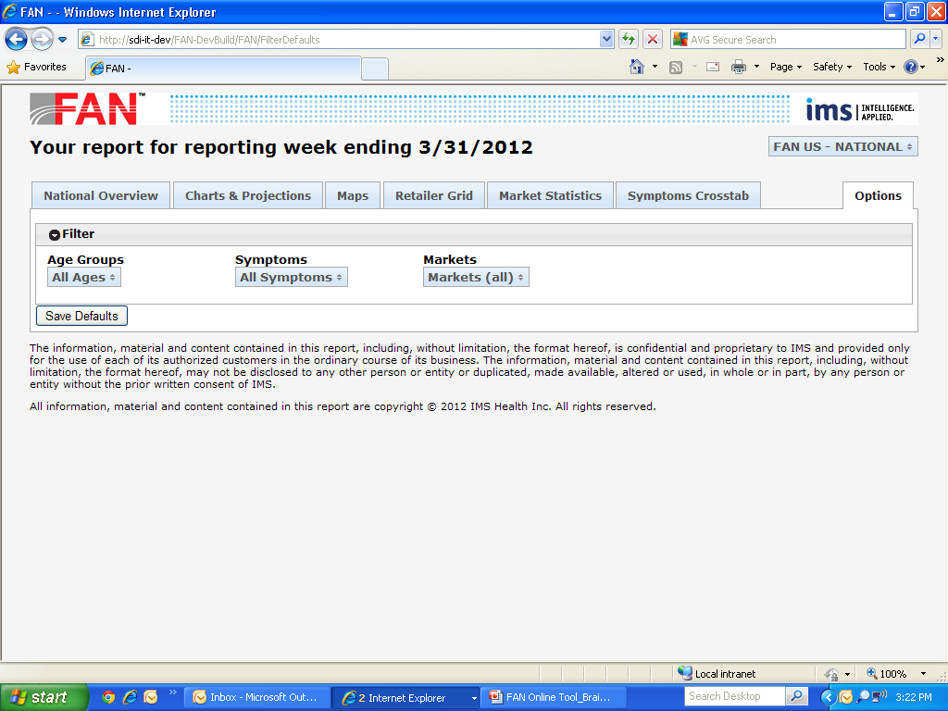
Options/Saved Settings
Notes:
Within the options menu , you can set their default settings for age groups, symptoms and markets.
For age groups , you can filter reports by all ages, adults and pediatric populations.
For symptoms , you can set default settings to include only specific symptoms from the list including: All symptoms, fever, ILI, ear ache, nasal and sore throat.
Under markets , you may select or unselect any markets you wish to include in the report.
Once settings are complete, save your settings by clicking ‘Save Default’ and these selections will be filtered in your reports until changed.

Slide 6
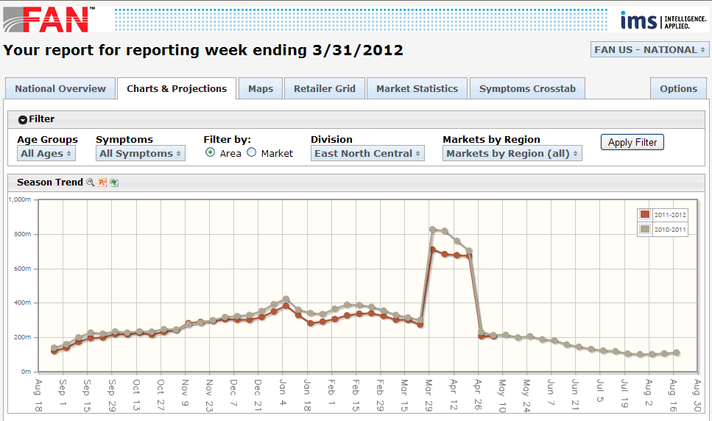
Charts & Projections
Notes:
In the next tab, we’ll review Charts and Projections.
In the FAN Online Reporting tool, there is one central line chart which allows you to filter by age, symptoms, division, market and area. This will allow you to create graphs specific to your business needs.
The central graph also allows you to zoom, and expands sections of the graph for a more detailed view. Simply highlight a portion of the chart to expand and the chart will resize based on your selection . Hitting the reset button next to the chart title will return you to your previous view.
Beneath the central chart, four pie charts will be displayed highlighting adult and pediatric age splits, lower level pediatric age splits, symptoms and geographic areas.

Slide 7
Maps
Static mapping will be available with FAN version 1.0
In the third quarter of 2012, IMS will release FAN version1.1
The new version will include interactive mapping features, heat maps, drill down capabilities and more.
Notes:
On the maps tab, you will see a display of the United States broken out by FAN’s 150 monitored markets. For each market, a color coded indicator will fill the market based on that market’s current status level. Below the core map lies a smaller map. The smaller map highlights the status levels of the markets from the same week in the previous year, allowing you to visually compare seasonal differences.
Although the initial release of FAN will contain static mapping, version 1.1 with an anticipated release in the third quarter of 2012 will include interactive mapping technology, featuring heat maps, drill down capabilities, custom client mappings and more.

Slide 8
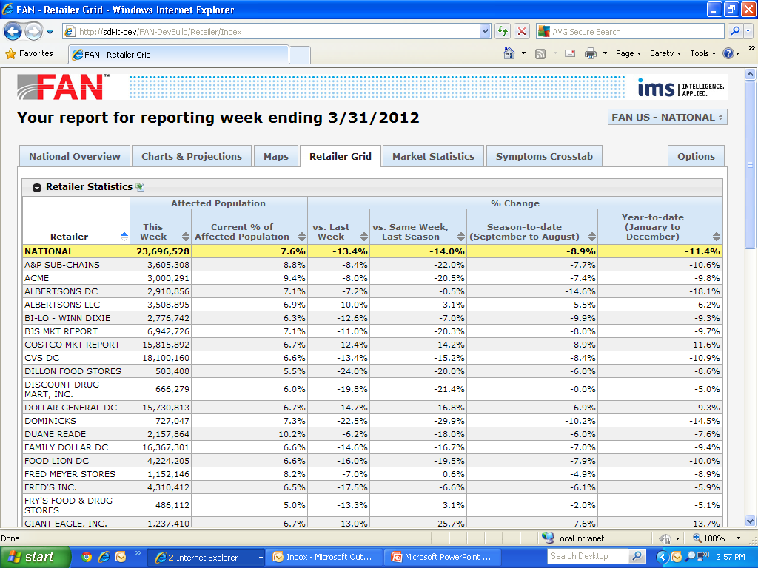
Retailer Grid
Notes:
The Retailer Grid tab breaks out each of the top retailers in the United States based on the their specific trading area’s affected population and by percent change metrics versus prior year for the same time period.
Within this tab, you may sort any of the available columns by clicking on the arrows next to each title.
In this example , the tool has been sorted alphabetically by retailer name as seen in the first column.

Slide 9
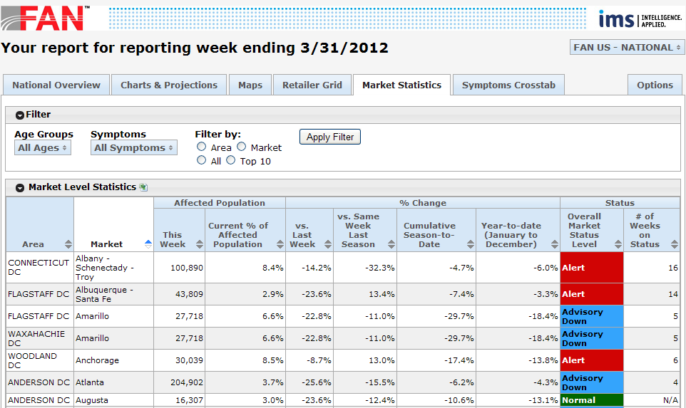
Market Statistics
Notes:
The Market Statistics tab provides you with an area and market level view of the affected population, percent change metrics and status level of each market.
This report allows you to filter the results by age groups, symptoms, area, market and top 10.
The last columns in this report shows the color coded status level of each market. Additionally, you can quickly identify how many weeks each market has been on the respective status level.

Slide 10
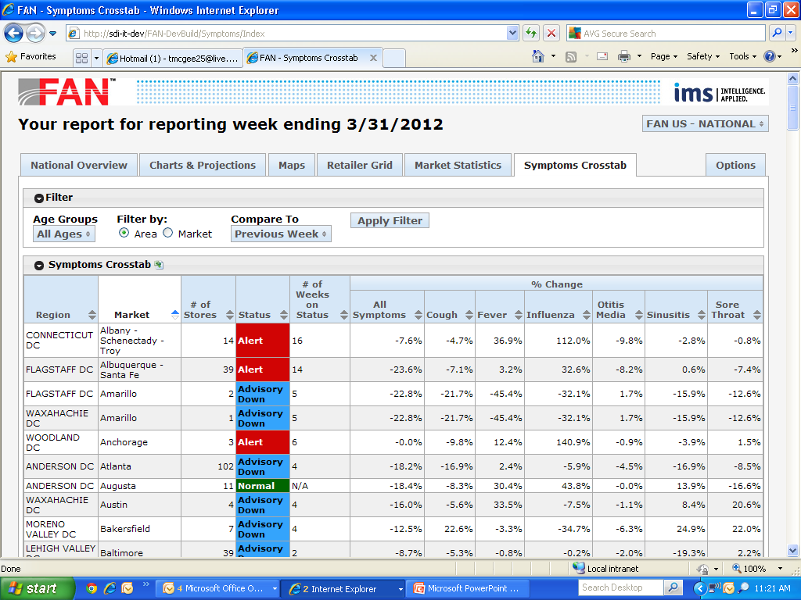
Symptoms Cross-tab
6
Notes:
The final tab of the FAN Online Reporting tool is the Symptoms Cross-tab. This allows you to view individual areas and markets by the change in affected population by symptom.
Key features of this report are client specific areas and markets loaded and maintained by IMS . For clients who purchase retailer specific reports, custom distribution centers and markets will be loaded into the tool and reported each week. In the national report, this view will show census area’s and markets.

Slide 11
FAN Online Reporting Tool
In the coming weeks, IMS client services will be reaching out to all clients to update distribution/access lists.
IMS will create and send user names and passwords for FAN52.com to all active FAN report users.
Access to the FAN52.com site will go live in early June and traditional Excel based reports will be delivered in tandem during launch.
IMS will notify all users when traditional Excel based reports will be discontinued via a pop-up message in the Excel report.
Notes:
IMS is happy to introduce this new and exciting interactive reporting tool.
In the coming week, IMS client services will be reaching out to confirm and update client distribution lists.
We will create and send user names and passwords to access FAN52.com to all active FAN report users.
Access to FAN52.com will become available in early June and traditional Excel based reports will be delivered in tandem during the first few weeks. This will allow you to become familiar with the new Online Reporting Tool and address any questions to IMS staff.
IMS will notify all users when traditional Excel based reports will be discontinued via a pop-up message in the Excel based report.

Slide 12
Contact Us
Please contact me or your account manager if you have any questions about the new FAN Online Reporting tool or to schedule training.
Tim McGee - Sr. Manager, OTC Health & Clinical Operations
tmcgee@us.imshealth.com
(610) 834-0800
Notes:
Thank you for viewing this online introduction to the FAN Online Reporting tool. Please contact me or your IMS account manager if you have any questions about the new Online Reporting or to set up a training session.
Thank you and have a nice day.

